Slide 1
How to succeed in Social & Mobile games ?
Lessons from GDC

Slide 2
Agenda
Why are social games important to us ? (Lazard)
How do Social games really work $ wise (Kongregate)
Making games for Mobile(Popcap, Halfbrick)

Slide 3
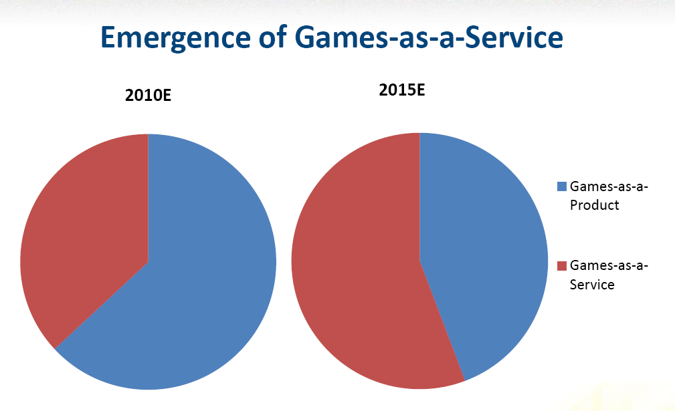
Emergence of Games as a service

Slide 4
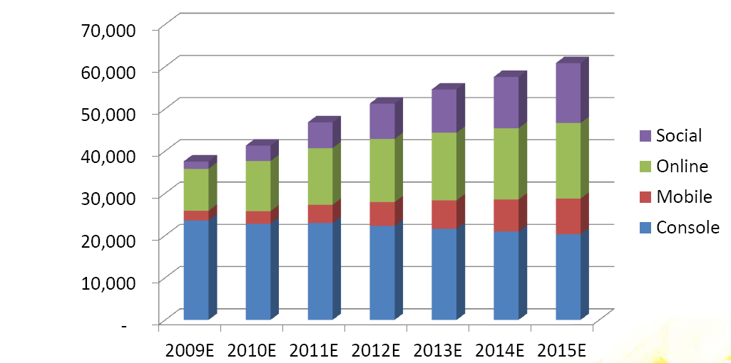
Market size evolution ($M)

Slide 5
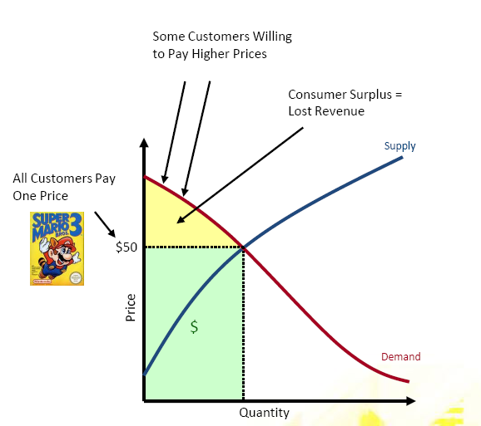
Traditional model represented lost value
Consumers willing to spend more on games were not able to
Satisfaction gained by winning, not by acquiring status

Slide 6
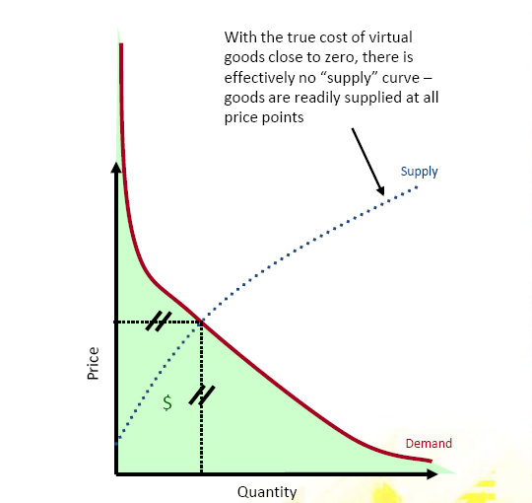
Virtual goods enable perfect pricing
Some hard-core gamers willing to spend $10K a month on virtual goods
A $100K space station can generate revenues and become an asset

Slide 7
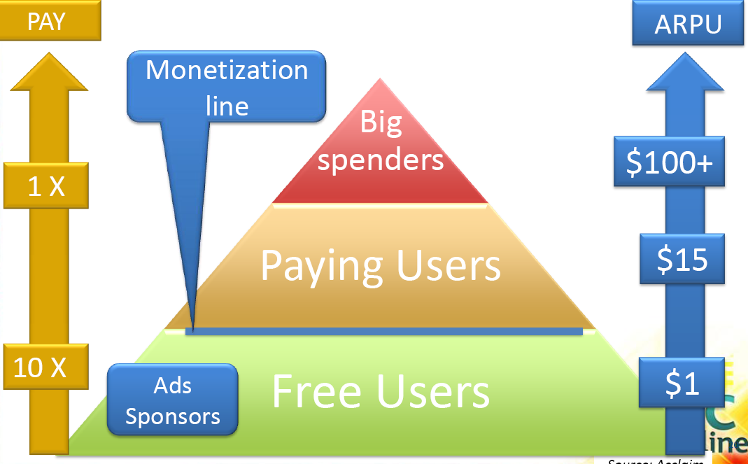
Everyone pays

Slide 8
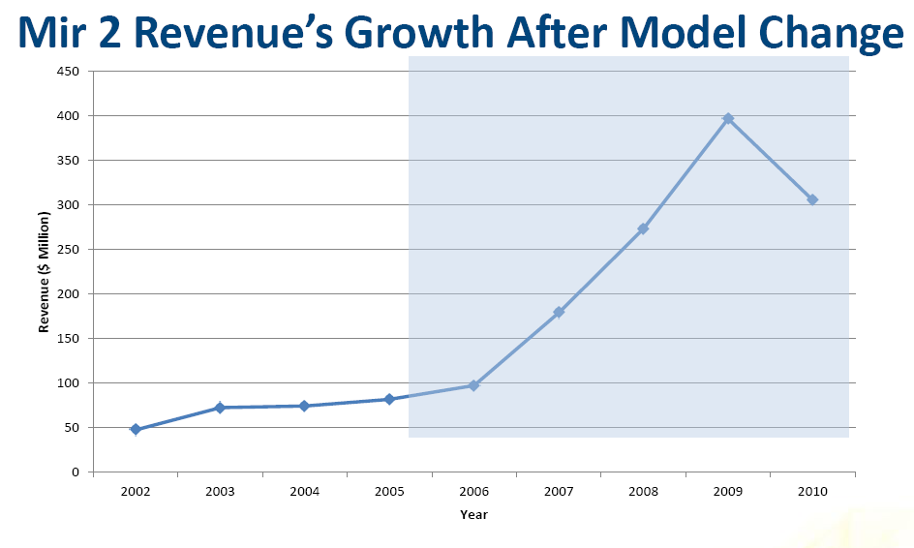
Shanda proved the model first

Slide 9
Some vocabulary
DAU : Daily Average users eg Cityville : 8M, FFF, 0.6M
MAU : Monthly Average user, eg Cityville : 45M, FFF, 2M
ARPU : Average Revenue Per Use, eg $0.03 per DAU or $0.25$ per MAU
ARPPU : Average Rev Per Paying User eg $10 to $50 per MAU
LTV : Life Time Value ARPU x Nb of months played
Numbers depend on success of the game
Averages vary a lot by genre, platform and country
Cf http://whatgamesare.com/2010/12/cityville-explained-final-part-social-games.html

Slide 10
How does it work ?
Distribute as many games as possible Exposure / Acquisition
Get players to play % Install and/or Nb of Play once
Get players to return % Regs (10), % Addicts (50)
Get players to buy once Most <1%, 2% is good
Get players to buy more eg Whales spend > 500$/month
Get players to invite friends K factor = invitation x conversion

Slide 11
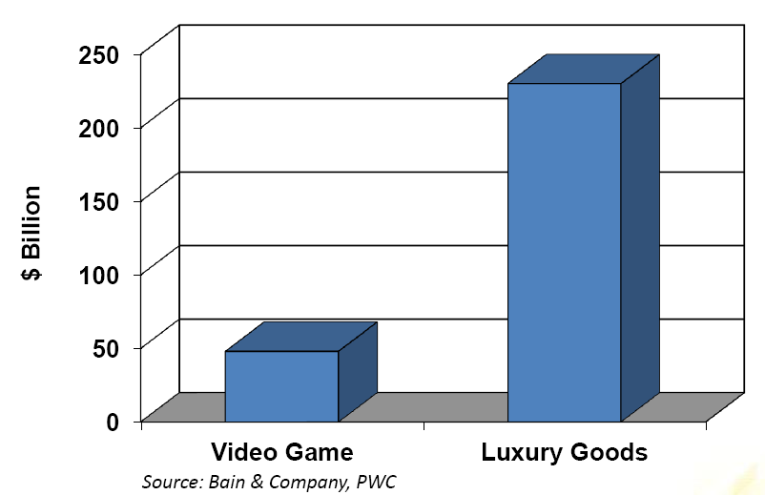
Social games are not just about game
They are also a mean of expressing oneself in virtual environment
Social games are also about Status

Slide 12
Lessons for Virtuos ?
Train on how to achieve real agility
Increase nb of demos : performance, back-end. Revisit existing demos.
Experienced PHP Lead
Find ways to increase concurrency (Ian)
Learn about online operations including data analysis (Cui Ying)
Set-up a team to finish Rome / one of IOS proposal (including all skillsets needed full-time)
Teach ARM framework to designers (certificate under way)
Need more Unity experience

Slide 13
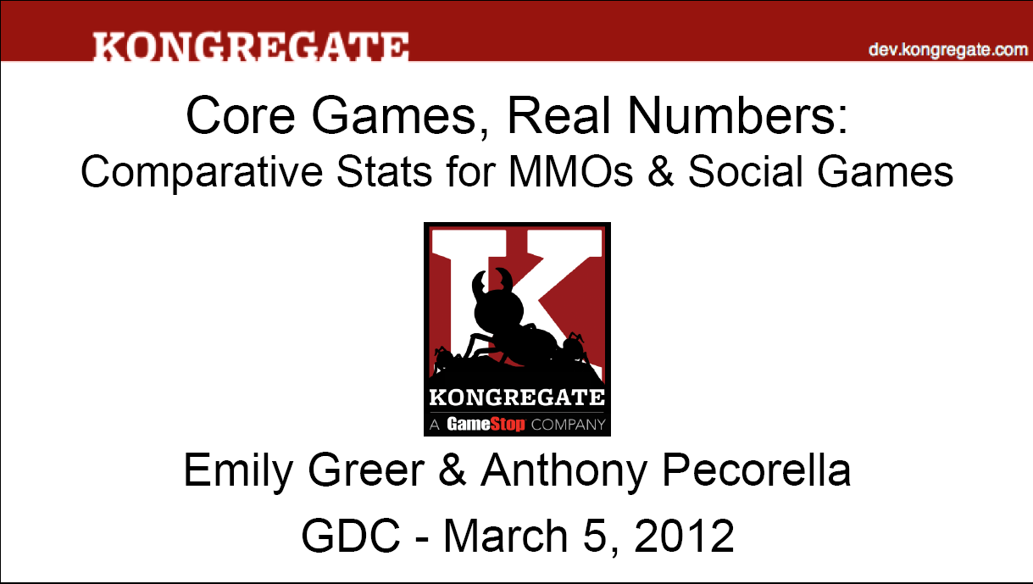
Kongregate

Slide 14
Lessons for Virtuos ?

Slide 15

Popcap

Slide 16
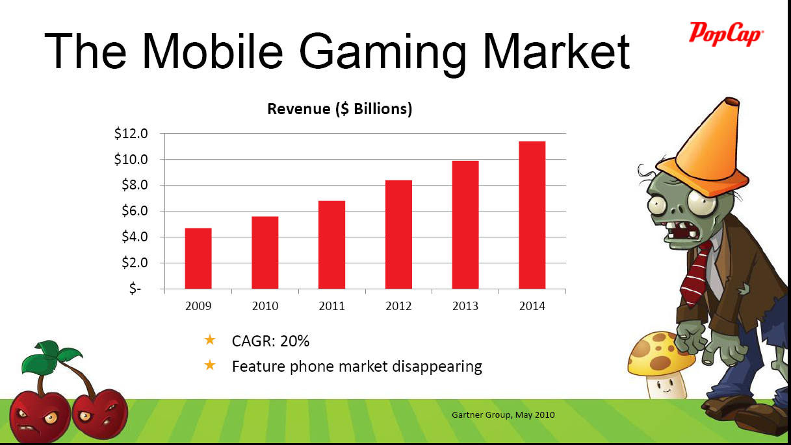
Mobile = additionnal Wave

Slide 17
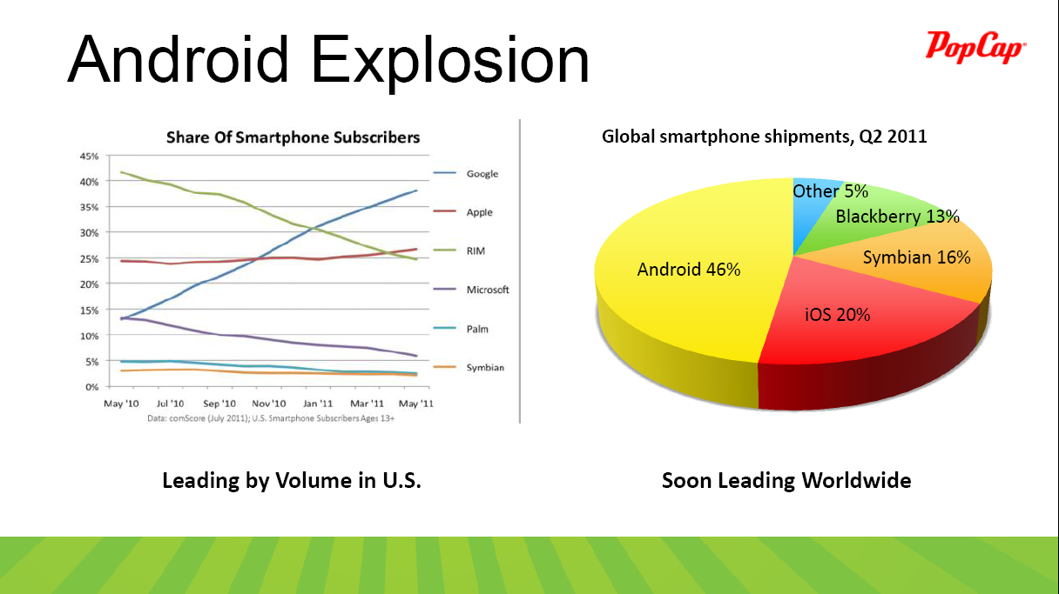
A duopoly

Slide 18
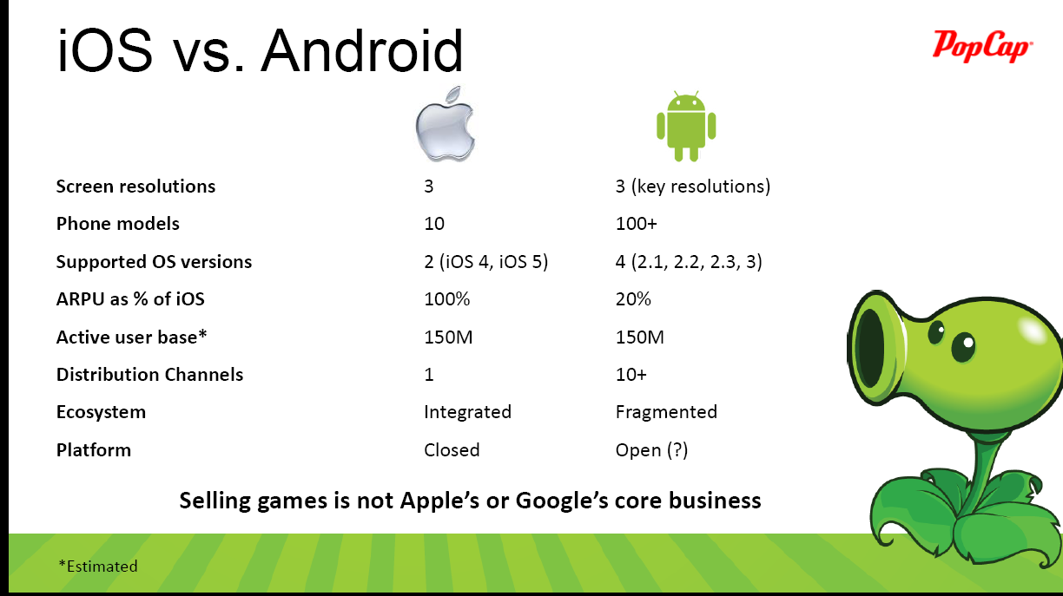
One vs Many

Slide 19
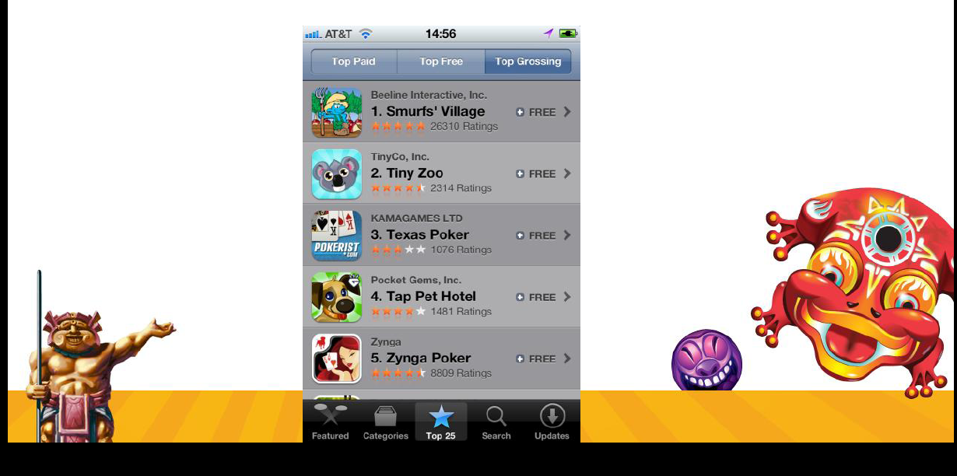
Freemium dominates

Slide 20
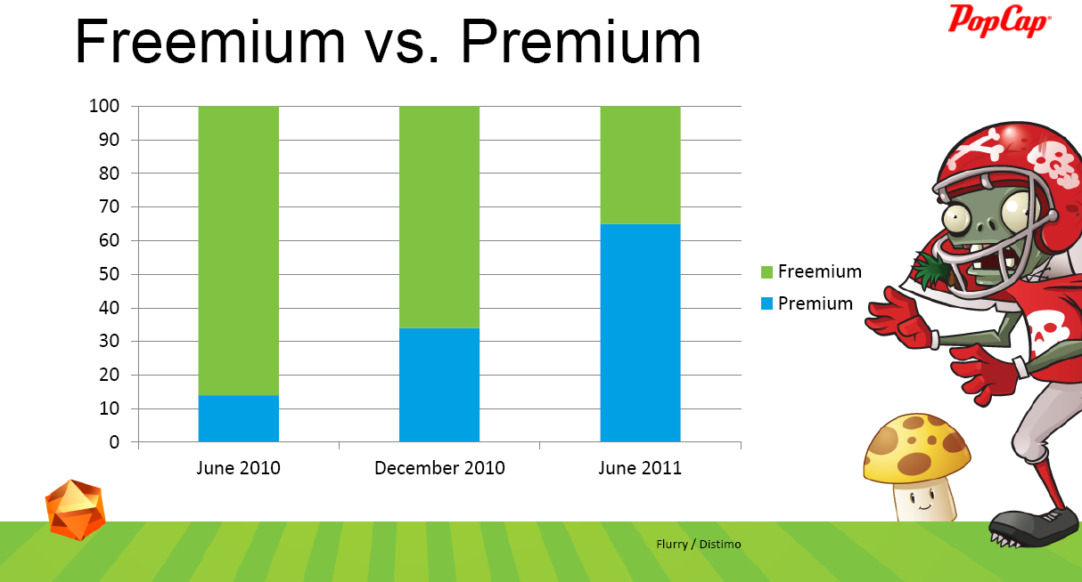
Freemium dominates

Slide 21
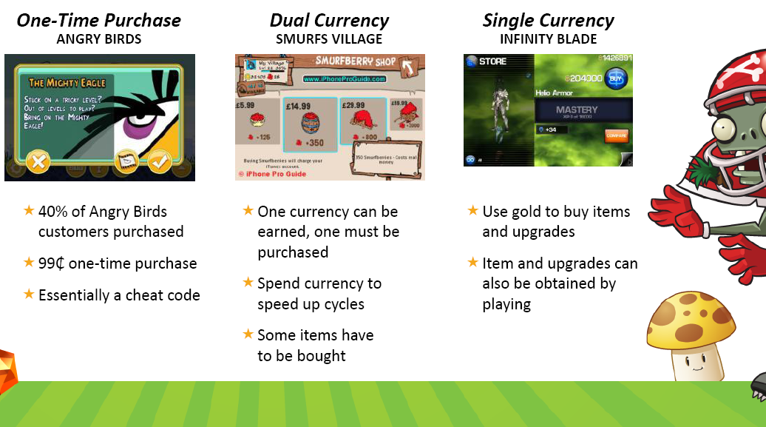
3 kinds of In-App Purchases

Slide 22
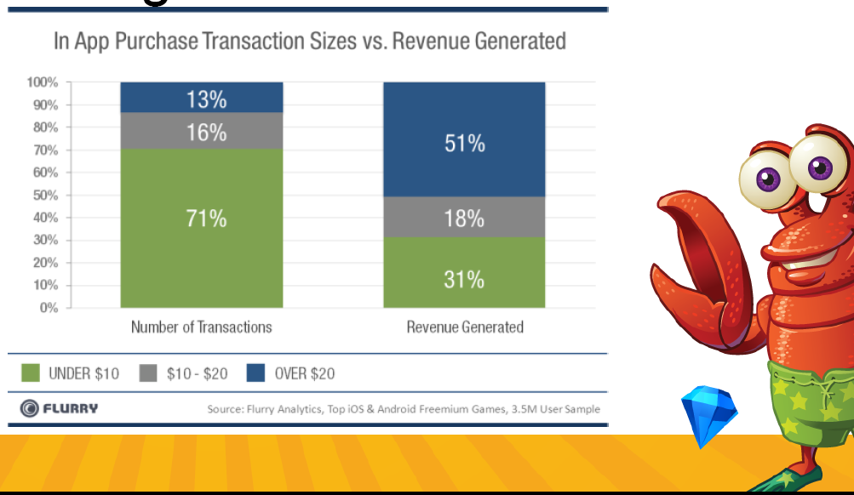
Whales also important on Mobile

Slide 23
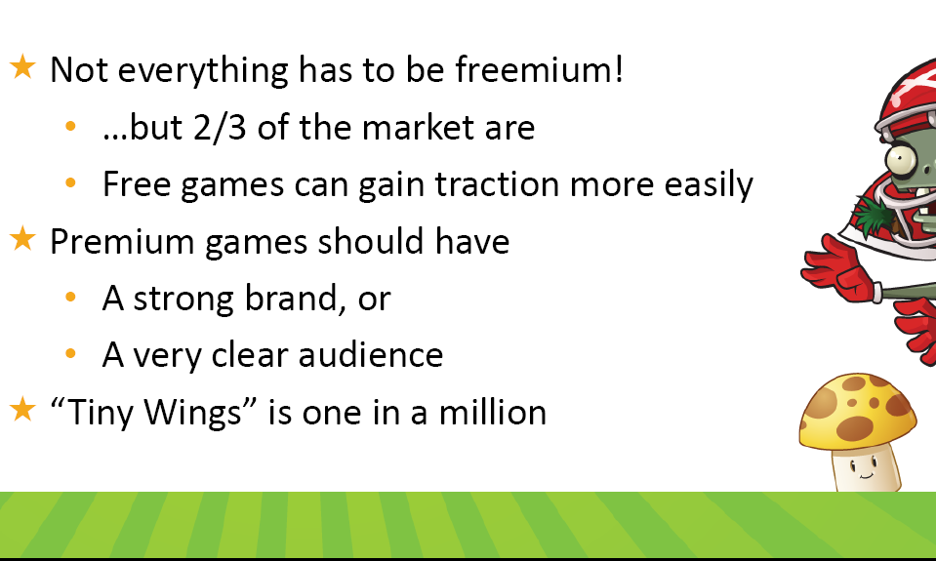
Not all freemium

Slide 24
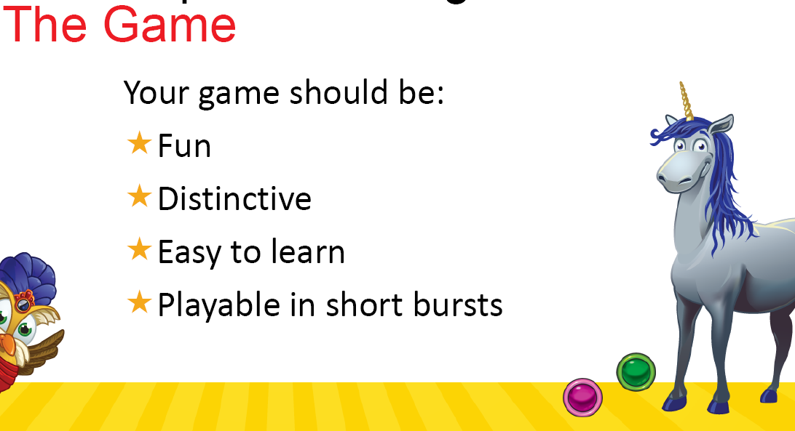
Succesful Mobile Game should be…

Slide 25
Lessons for Virtuos ?

Slide 26
Mobile Dev lessons from Gamevil
Research on trends
Lots of meetings about game mechanics ideas, prototypes
Native C++ for better results on IOS and AN : Cocos, Unity, Unreal
Build infrastruture to measure key metrics
Launch on both IOS and AN at same time
Drop lower machines : now, no need for 3GS
Make it flexible enough that changes made in lead platform will auto port
Make flexible floating menus that will auto adapt to any device
If 2M$ for one game, will develop sequel

Slide 27
Mobile Dev lessons from Halfbrick
Fruit Ninja : 3 guys, 6 weeks
Update soon after launch to show commitment
Fast fix = fans won
Add « rate us » after players reach high score
Add long term goals with rewards to increase stickyness
Today cannot ship Lean anymore

Slide 28
Lessons for Virtuos ?

Slide 29
Thank You!
Business inquiries: North-America damien@virtuosgames.com Outside North-America philippe@virtuosgames.com Virtuos Ltd – 10F, 1326 Yanan Xi Lu - 200052 Shanghai Tel : +86 21 5258 3300 -Fax : +86 21 64642322 www.virtuosgames.com

